Slide 1

Quantum Machine Learning in small drug discovery

Slide 2
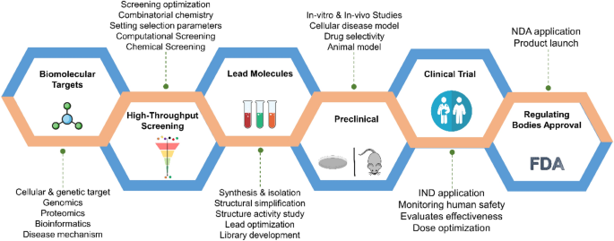
Challenges in De Novo Drug Discovery
Complex and Resource-Intensive Process
Drug development is a time- and resource-consuming endeavor.
Low probability of success, with only approximately 4% of preclinical drugs eventually granted licenses.
Lengthy Journey to Market
New medicine development takes a minimum of ten years to go from initial discovery to market availability.
High Research and Development Costs
Estimated median capitalized R&D cost per new drug (2009-2018): $985 million, accounting for the cost of failures.
Generic Drug Research Pipeline
Four main processes:
Target identification
Lead identification and screening
Lead optimization
Clinical trials
Computational Challenges
Lead identification and lead optimization are conducted on classical computers.
Huge Hilbert Space for drug molecules due to numerous atoms.
Approximately 10^47 protein structures predicted from just 100 amino acids.
Searching this vast Hilbert Space is an NP-Hard problem for traditional computers.
Notes:
Time consuming-resource consuming-cost intensive-10^47

Slide 3
Advancing Drug Design with AI: From Conventional Methods to De Novo Molecule Design
Conventional Drug Design Approaches
Ligand-Based Drug Design (LBDD): Utilizes known active binders for target identification.
Fragment-Based Drug Design (FBDD): Assembles small molecular fragments into drug-like compounds.
Structure-Based Drug Design (SBDD): Focuses on the active site properties of biological targets.
The Role of Artificial Intelligence (AI)
Breakthroughs in De Novo Molecule Design.
AI is revolutionizing the drug discovery process.
AI-Powered Generative Algorithms
Evolutionary Algorithms (EA): Explore chemical space for novel molecules.
Recurrent Neural Networks (RNNs) - e.g., GRU and LSTM: Generate sequences of molecular structures.
Autoencoders - e.g., AAE and VAE: Learn latent representations for molecule generation.
Generative Adversarial Networks (GANs): Employ adversarial training for molecule design.
MolGAN: A GAN for Graph-Structured Data
Specifically designed for de novo design of small molecules.
Operates directly on graph-structured data.
Demonstrated to generate close to 100% valid compounds.
Successful experiments on the QM9 chemical database.
Notes:
Generative learning with graph-structured molecules is invariant to the orderings of atoms and automates the navigation to a chemical region abundant in desired molecules

Slide 4
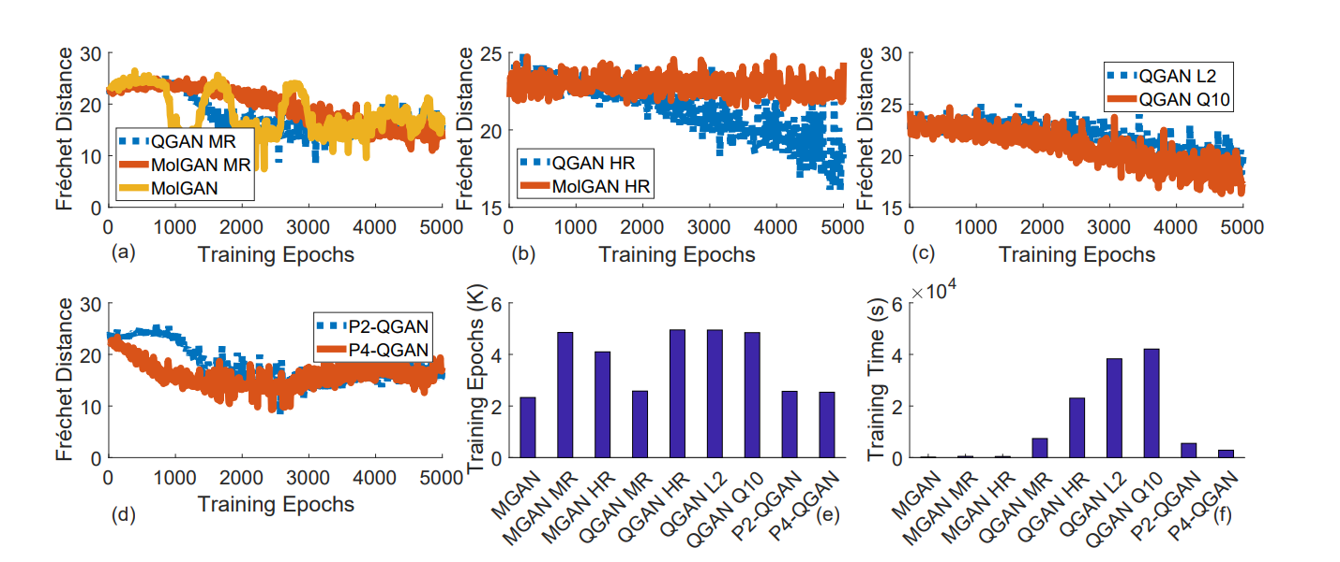
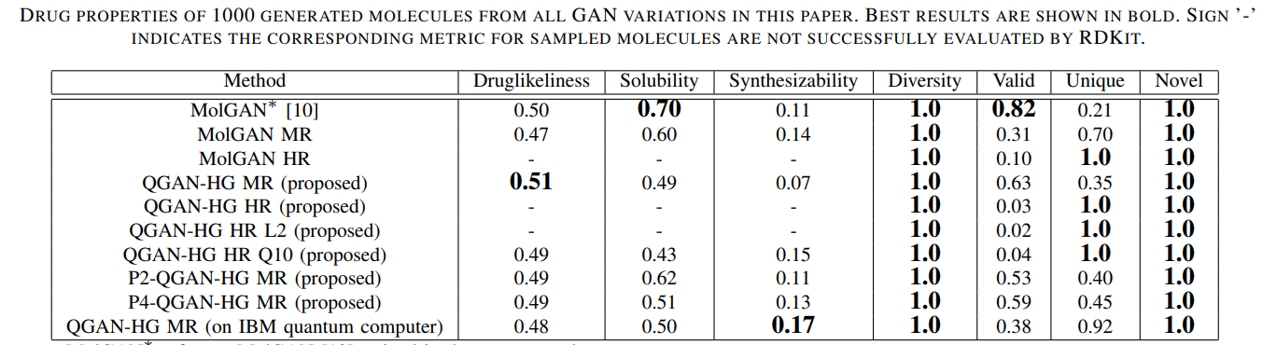
Unlocking the Potential of Quantum GANs in Drug Discovery
Variational Quantum Circuit (VQC)
Demonstrated advantages in:
Expression power
Learnability
Robustness
Quantum GAN (QuGAN) vs. Classical GAN
Exponential advantages of QuGAN over classical GANs.
Quantum information processors represent N-dimensional features using log N qubits.
Time complexity: O(poly(log N)).
Benefits of Quantum GANs
Quantum speedup in runtime.
Enables deeper models for richer molecule representations.
Amplitude amplification property enhances learning.
Ability to explore exponentially large chemical space with a limited number of qubits.
Samples from distributions challenging to model classically.
Opportunities in Drug Discovery
Quantum GANs offer:
Faster drug discovery processes.
Exploration of diverse molecular structures.
Sampling from complex chemical distributions.
Potential breakthroughs in molecule design.
Notes:
Several studies have demonstrated that variational quantum circuit (VQC) performs the advantages in expression power, learnability, and robustness.
QuGAN’s exponential advantages over classical GANs directly result from the ability of quantum information processors to represent N-dimensional features using log N qubits with time complexity of O(poly(log N)).
Recent studies also showed that generative models implemented by quantum circuits with fewer architectural complexities could easily bypass their classical counterparts.
Quantum GANs can offer several opportunities e.g., (i) quantum speedup in the runtime making it possible to learn richer representation of molecules via deeper models due to the amplitude amplification property; (ii) ability to search exponentially large chemical space with few qubits and sample from distributions that may be difficult to model classically. However, classical generative models cannot generate all possible distributions indicating that it cannot explore certain regions of the chemical space. This is primarily due to exponential choices to gradually add a new molecule in the existing drug fragment.
Given the task complexity of learning molecule distribution, full quantum GAN can hardly encode all training data in a quantum way
In the NISQ era, there is a qubit restriction on gate-based quantum computers. Therefore, now is the ideal moment to create quantum algorithms for molecular simulations so that, when better quantum computers become accessible, we may hasten the process of drug development

Slide 5
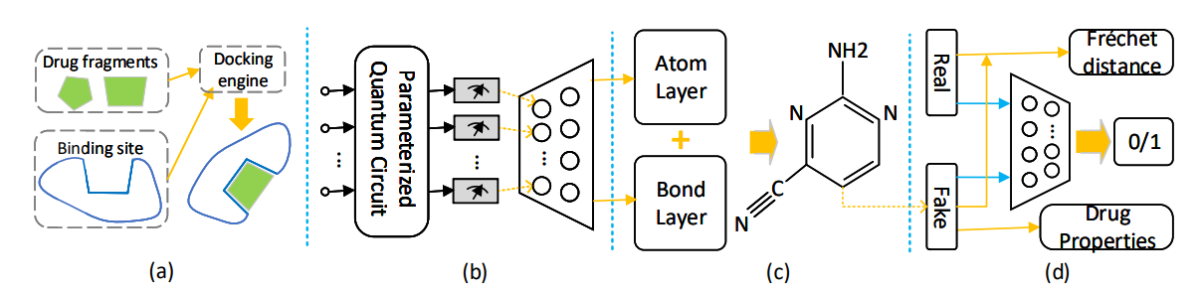
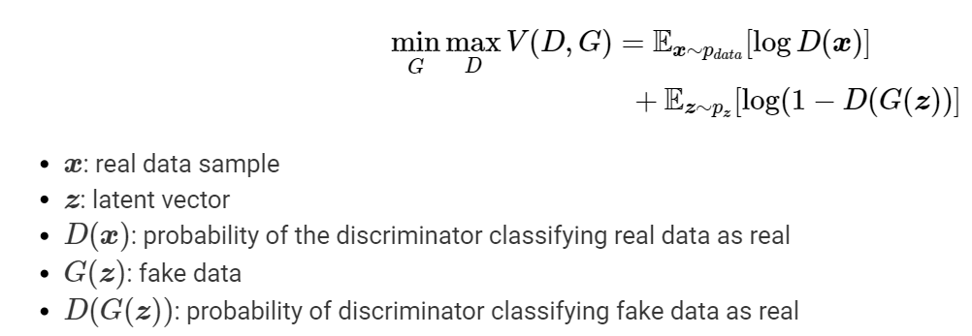
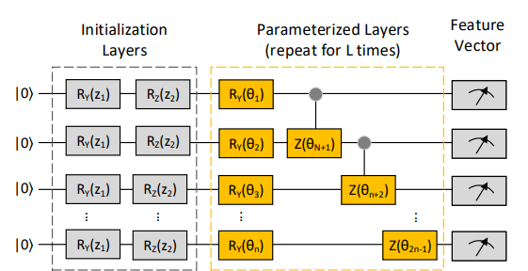
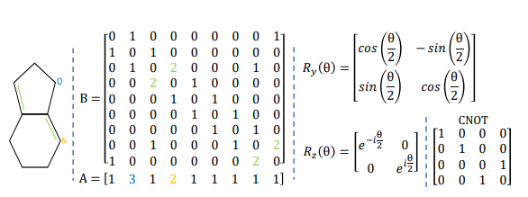
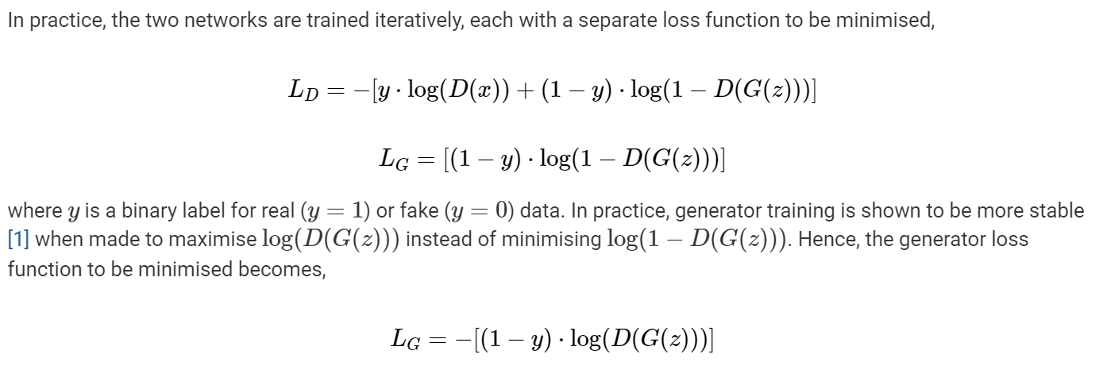
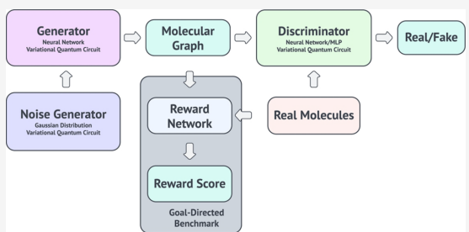
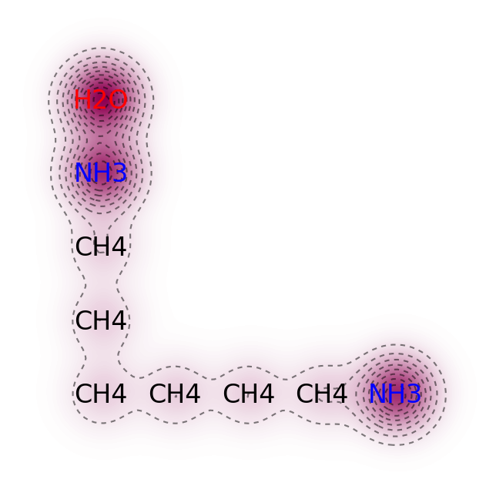
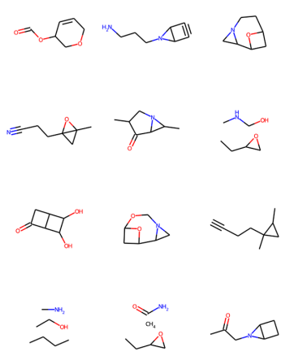

METHOD

Slide 6
Evaluation Metrics
Quality Metrics
Validity: Ratio of valid molecules to all generated molecules.
Uniqueness: Ratio of unique molecules to valid molecules.
Novelty: Ratio of valid molecules not in the training dataset to all valid molecules.
Diversity: Measures how diverse generated molecules are compared to the training dataset.
Drug Properties
Quantitative Estimation of Drug-Likeness (QED): Measures the likelihood of a molecule being a drug based on desirability.
Solubility: Reports the n-octanol-water partition coefficient (logP), indicating hydrophilicity.
Synthesizability (SA): Quantifies ease of synthesis based on molecular complexity and fragment contributions.
Dataset
All experiments use the QM9 dataset, derived from the GDB-17 chemical database.
QM9 contains 133,171 molecules with up to nine non-hydrogen atoms (C, N, O, F).
Average QED, solubility, and SA of QM9 molecules are 0.461, 0.289, and 0.327, respectively.
Evaluation Metrics
Frechet Distance: Measures similarity between real and generated molecule distributions.
Kullback-Leibler (KL) Divergences: Assess how well a distribution approximates another. KL-divergence scores indicate better distribution capture.

Slide 7
Future Scope of the Project
Integration of VQCs in Discriminator and Noise Generation
Utilize Variational Quantum Circuits (VQCs) within the discriminator for enhanced quantum-based discrimination.
Explore the application of VQCs to generate quantum noise for improved training and generation.
Comparative Study with Quantum Machine Learning Methods
Conduct a comprehensive comparative study with other quantum machine learning techniques, such as quantum kernels and quantum perceptrons.
Evaluate the merits and demerits of VQCs in the context of generative quantum models.
Synergy with QGAN Model
Investigate the potential benefits of combining other QML approaches with the Quantum Generative Adversarial Network (QGAN) model.
Explore how these methods can work synergistically to achieve even further improvements in generative capabilities.

Slide 8
References-
J. Li, R. O. Topaloglu and S. Ghosh, "Quantum Generative Models for Small Molecule Drug Discovery," in IEEE Transactions on Quantum Engineering, vol. 2, pp. 1-8, 2021, Art no. 3103308, doi: 10.1109/TQE.2021.3104804.
Exploring the Advantages of Quantum Generative Adversarial Networks in Generative Chemistry Po-Yu Kao, Ya-Chu Yang, Wei-Yin Chiang, Jen-Yueh Hsiao, Yudong Cao, Alex Aliper, Feng Ren, Alán Aspuru-Guzik, Alex Zhavoronkov, Min-Hsiu Hsieh, and Yen-Chu Lin Journal of Chemical Information and Modeling 2023 63 (11), 3307-3318 DOI: 10.1021/acs.jcim.3c00562
https://pennylane.ai/qml/demos/tutorial_quantum_gans

